Slide 1
PASSWORD MANAGEMENT
SECURITY SOLUTION: PASSWORD MANAGEMENT
WHAT IS PASSWORD MANAGEMENT ?
WHY DO WE NEED A PASSWORD MANAGER?
SECURITY SOLUTIONS PROVIDED BY PASSWORD MANAGEMENT
BITWARDEN
SECURITY ANALYSIS OF THE BITWARDEN
KEY FEATURES AND USES OF BITWARDEN
TUTKU YAVAŞ 18030411036

Slide 2

WHAT IS PASSWORD MANAGEMENT ?
Password management is a computer program that allows creating, storing and managing passwords in order to ensure digital security of users in today's technology. We can also say that it is a safer and more practical application of writing our notes in a notebook with its additional features.

Slide 3
WHY DO WE NEED A PASSWORD MANAGER?
To register for any site, we need to create an e-mail and password. If a secure password is not created, our accounts can be stolen and used for malicious applications. There is a serious amount of password leaks on major websites every year, causing financial and moral damages. Using the same login credentials everywhere means hacking all accounts. According to a Google study, only 66% of Americans use the same password on more than one online account. This rate is 55% in the world, according to research by Virginia Tech. In addition, situations such as not creating a strong password, continuing to use the same password after the account has been hacked, not using multi-factor authentication and saving the passwords in the phone's notebook do not provide our digital security. In this case, using password managers, one of the most important parts of information security, should become widespread due to the many features they provide.

Slide 4
SECURITY SOLUTIONS PROVIDED BY PASSWORD MANAGEMENT
Strong password generation.
Unlimited password storage for passwords that only we can see.
Not having to remember every password.
Saving time by filling out website forms easily.
Managing passwords and managing IDs and cards.
Storing text or files that must be important and private.
With its main benefits and many other features, it is a security solution that provides digital security to prevent the user from experiencing any password leakage or similar situations.

Slide 5
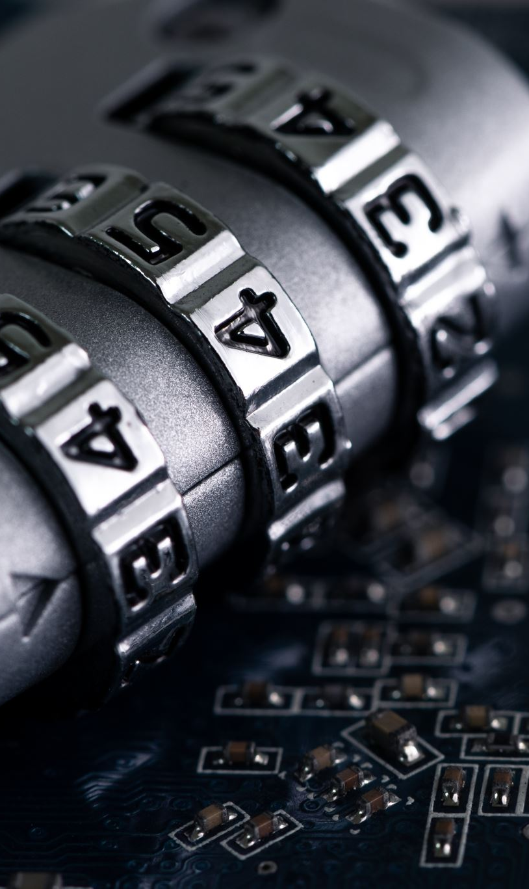
BITWARDEN
It is an open source computer program that provides password management, creates, stores and manages passwords. Since it is open source, it has high reliability. It is highly preferred with its features and ease of use.

Slide 6
SECURITY ANALYSIS OF THE BITWARDEN
Bitwarden is one of the best password managers. Being an open source password manager makes Bitwarden a more secure option than others because many cybersecurity experts around the world have independently reviewed the source code. Bitwarden allows users to change the master password only if the old password is known. If you forget your password, you can reset your Bitwarden account, provided that you lose all your data.
Note: If a password manager can send you a link via email that allows you to reset your master password, this indicates that it has stored the encryption key somewhere, and if this password manager is hacked, hackers can also retrieve the key or reset it.

Slide 7
Bitwarden is a password manager with open source code.
256 bit AES encryption (the first public encryption algorithm approved by the NSA for use in encrypting top secret information.Considering that your encryption using a 256 bit key requires 2^200 processes ( attack) to decrypt, the time it will take is more than the age of the universe).
Advanced 2FA options. (2 factor authentication is a second step for security when we enter our accounts. It is usually applied in the form of entering a code next to the password with an SMS sent to the phone and creates a security layer.)
Zero information policy (Bitwarden cannot access users password vault)
Biometric logins (identification by defining the physical or behavioral characteristics of the person, for example: voice, signature and keystrokes, fingerprint, face, iris, palm recognition)
Email verification
USB tokens (The USB token is used to electronically prove the user's identity and thus increase digital security.)
Secure password sharing.
Ability to store encrypted data in our own private servers.
TOTP authenticators (The time based one time password algorithm is part of 2FA. Its non-reusability creates a security layer.)

Slide 8
KEY FEATURES AND USES OF BITWARDEN
Password generator (5-128 characters)
Unlimited password storage
Auto save-fill
Multi device synchronization
Digital wallet (credit-debit card)
Identity storage (personal information for web forms)
Safe notes
Password sharing
Password check
Safe storage
Self host option (suitable if you have access to your highly secure private server)
Premium Features
Password sharing for up to 6 people and an additional 1GB of storage space for each
Password vault auditing.
Password breach reports.
1 GB encrypted storage.
Emergency Access
Two-step Login with YubiKey, U2F, Duo
Vault Health Reports

Slide 9
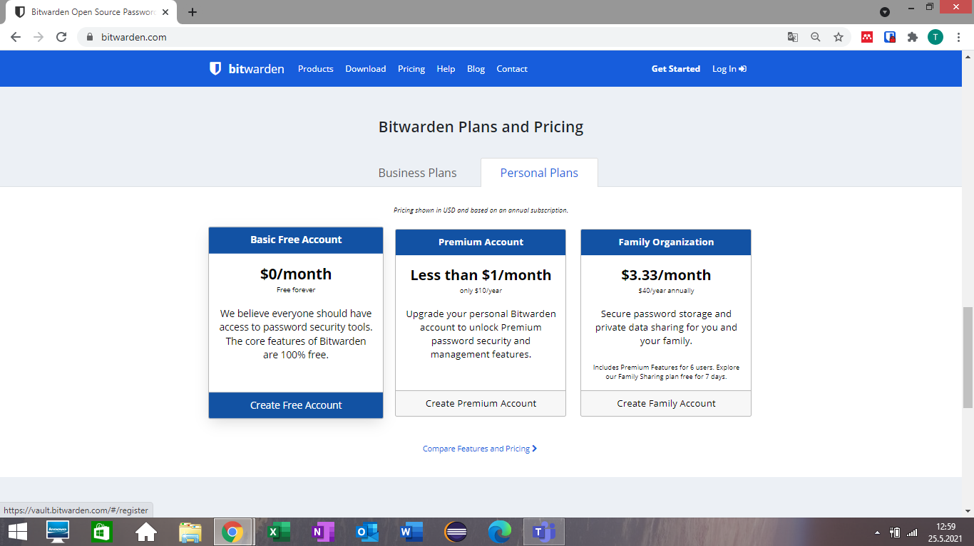
How to setup and use ?

Slide 10
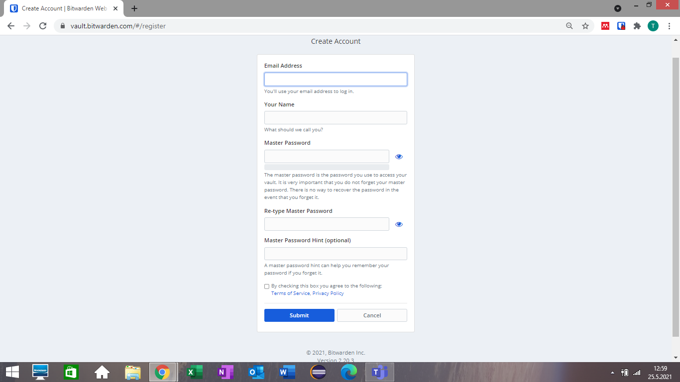

Slide 11
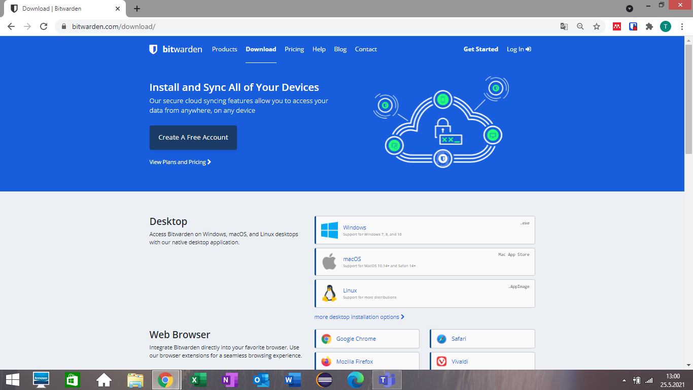

Slide 12
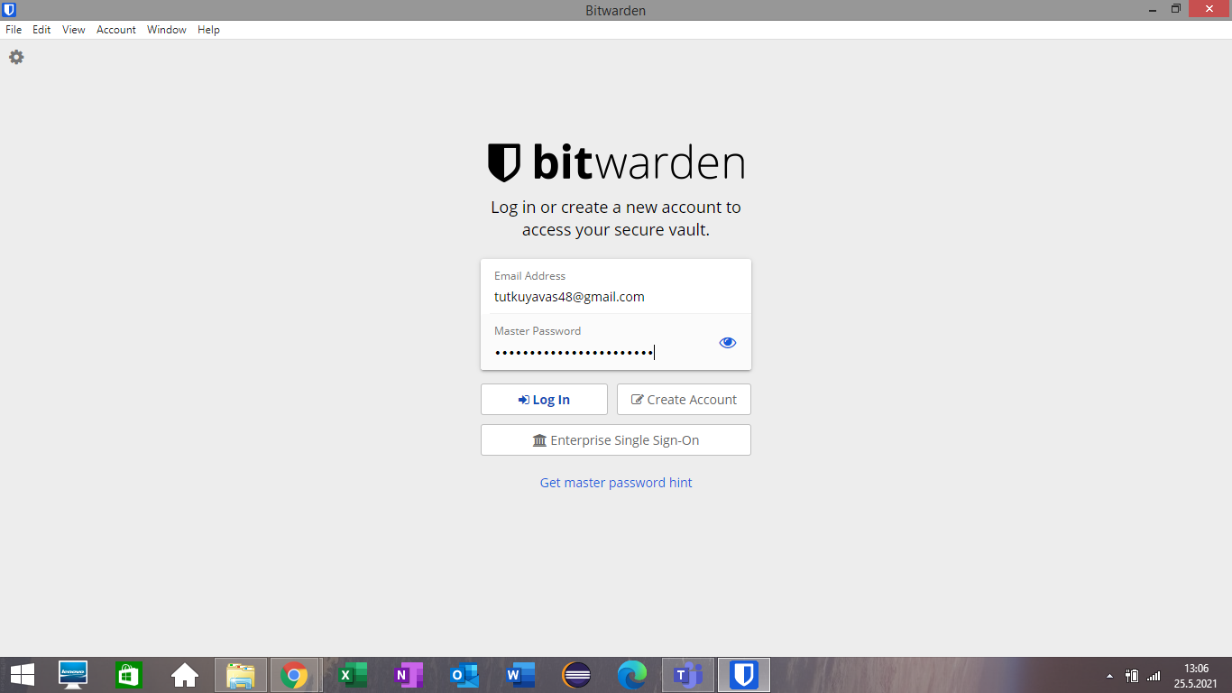

Slide 13
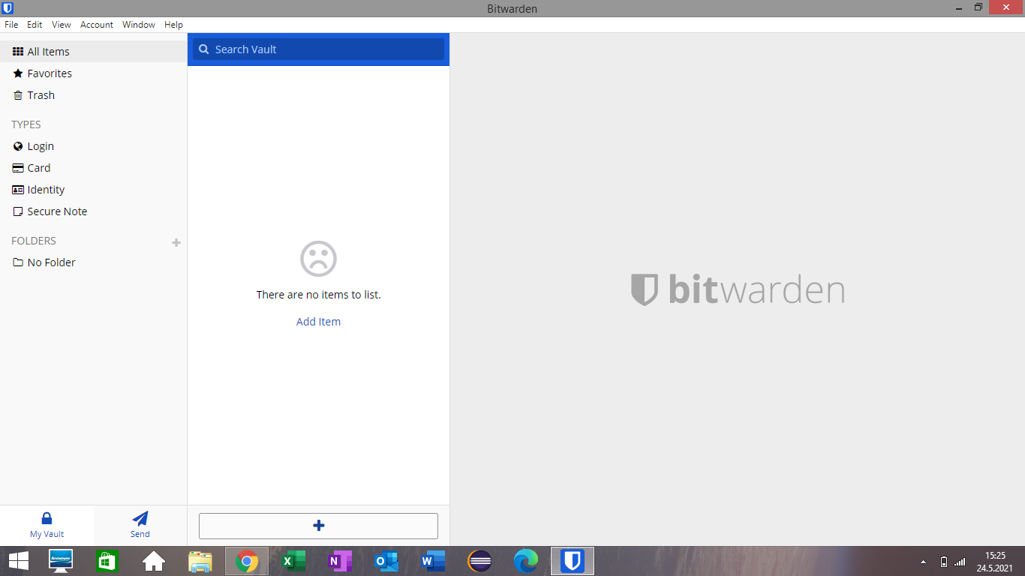

Slide 14
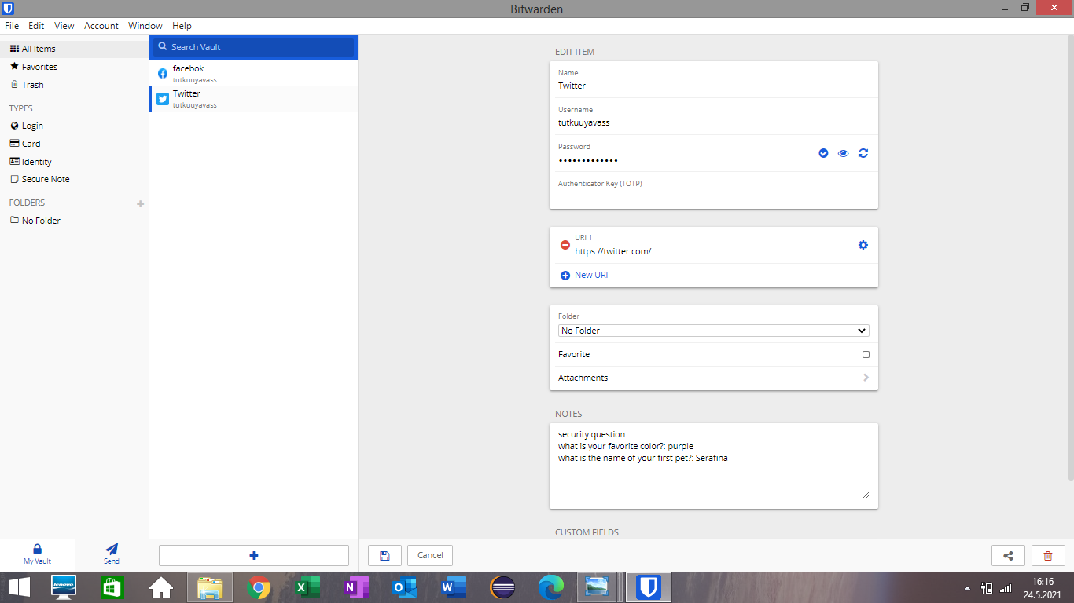
Unlimited password storage

Slide 15
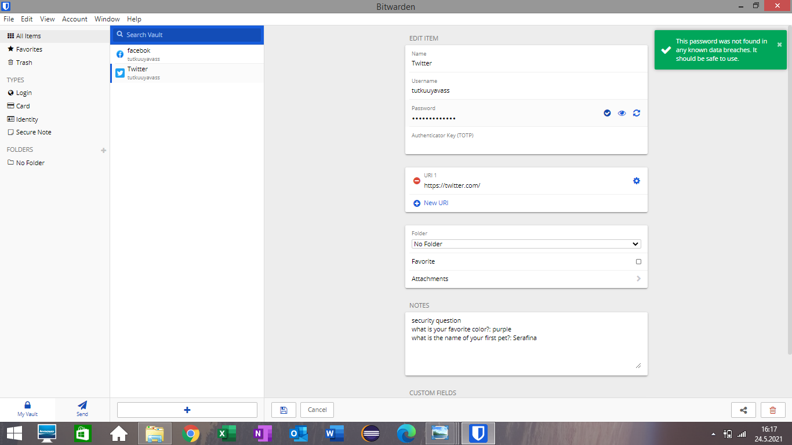
Checks to see if the password has been in any known breaches

Slide 16
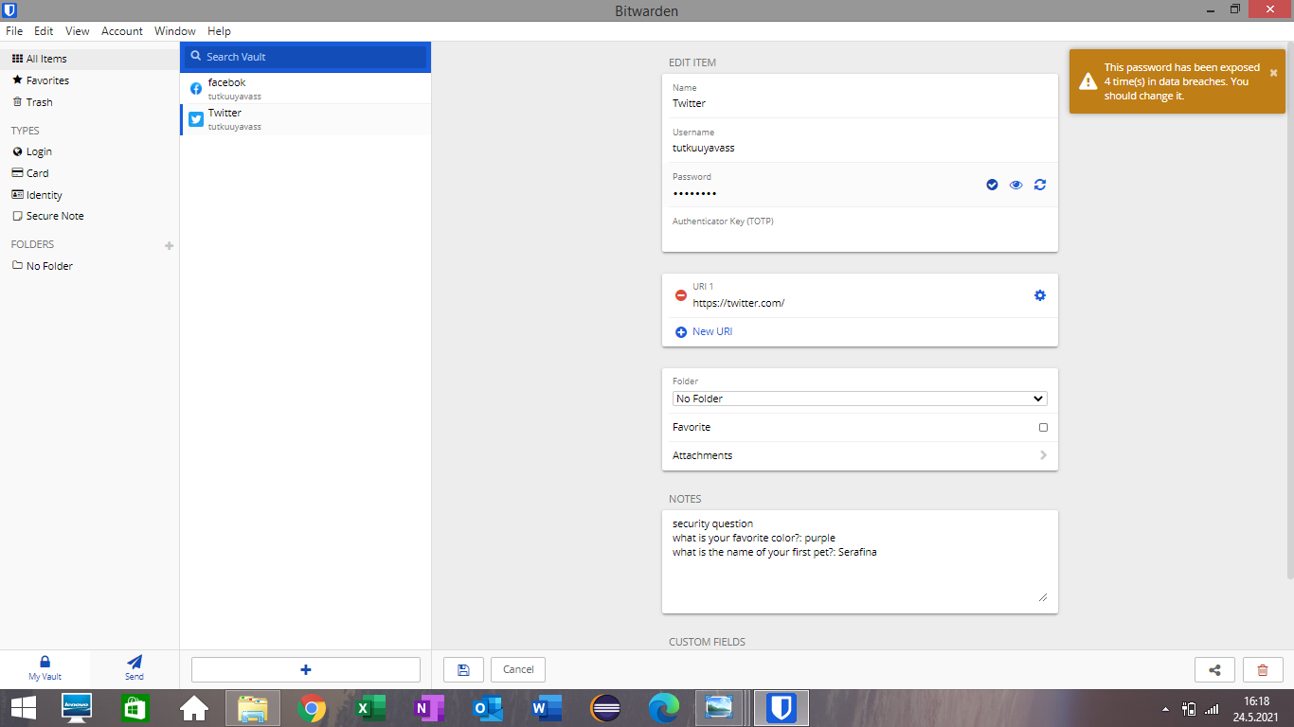
Generates a secure password for you

Slide 17
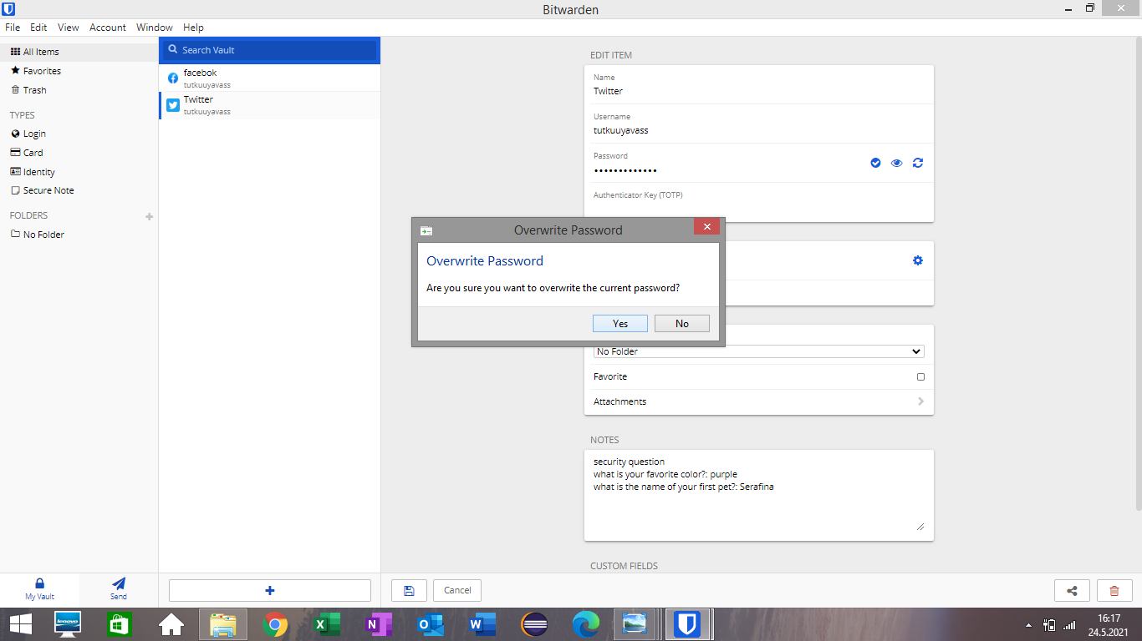

Slide 18
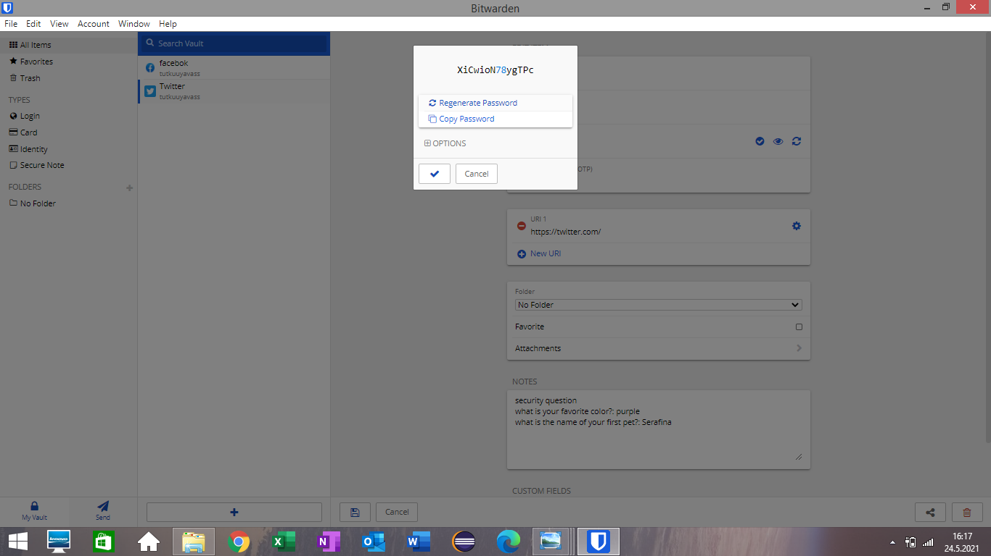

Slide 19
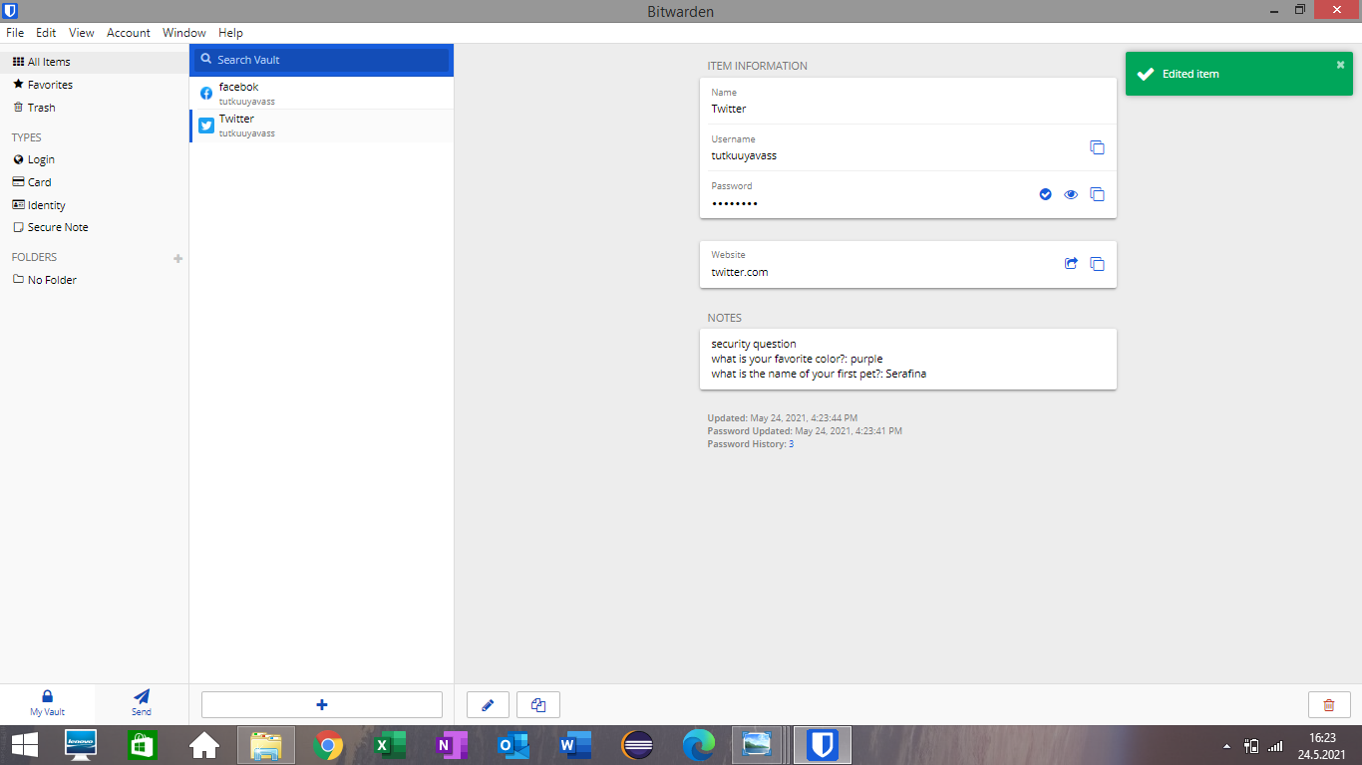
Shows how many times you have changed your password in the past.

Slide 20
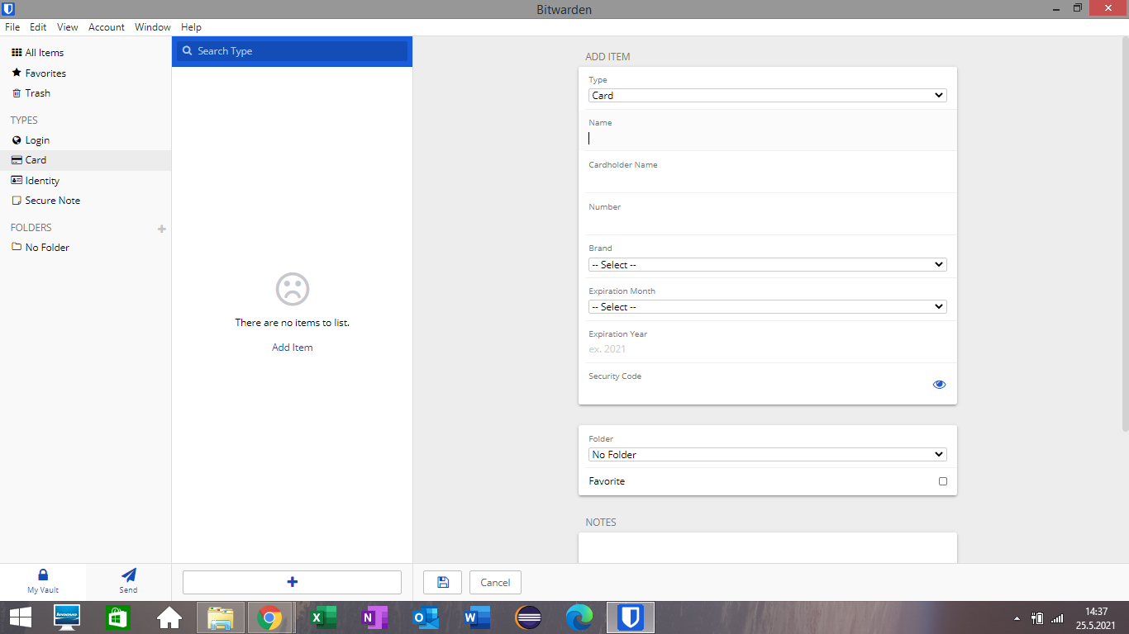
You can also manage your credit / debit cards

Slide 21
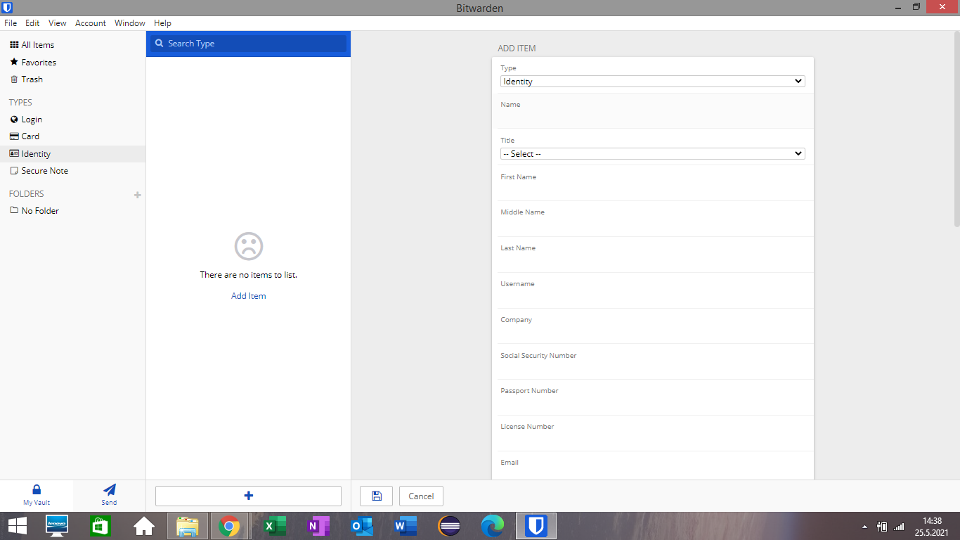
You can manage your identity.

Slide 22
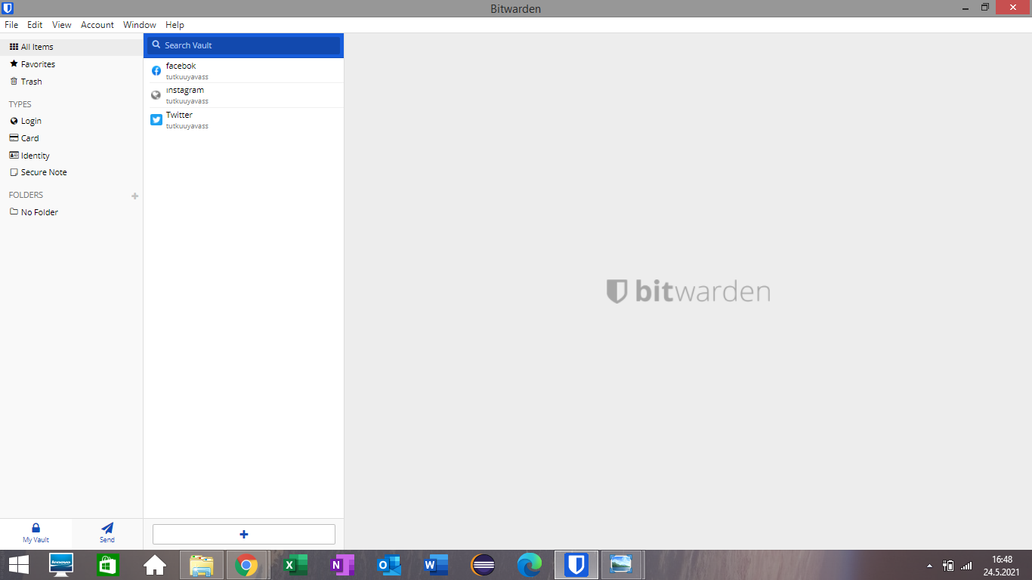
You can securely send your important text or files.

Slide 23
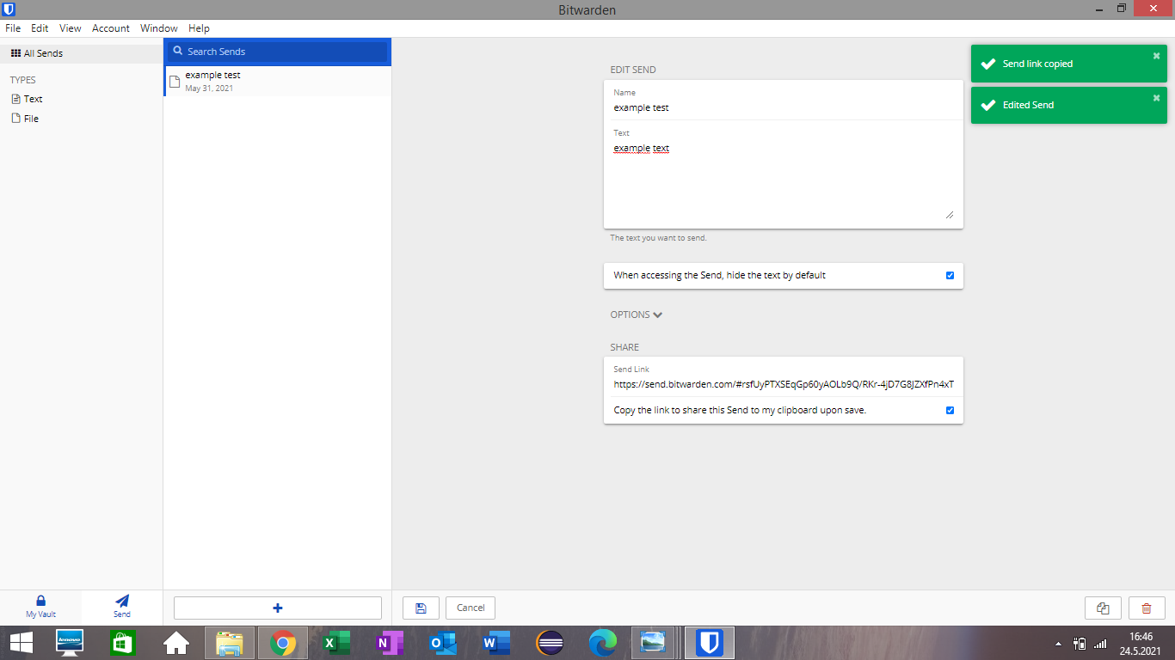

Slide 24
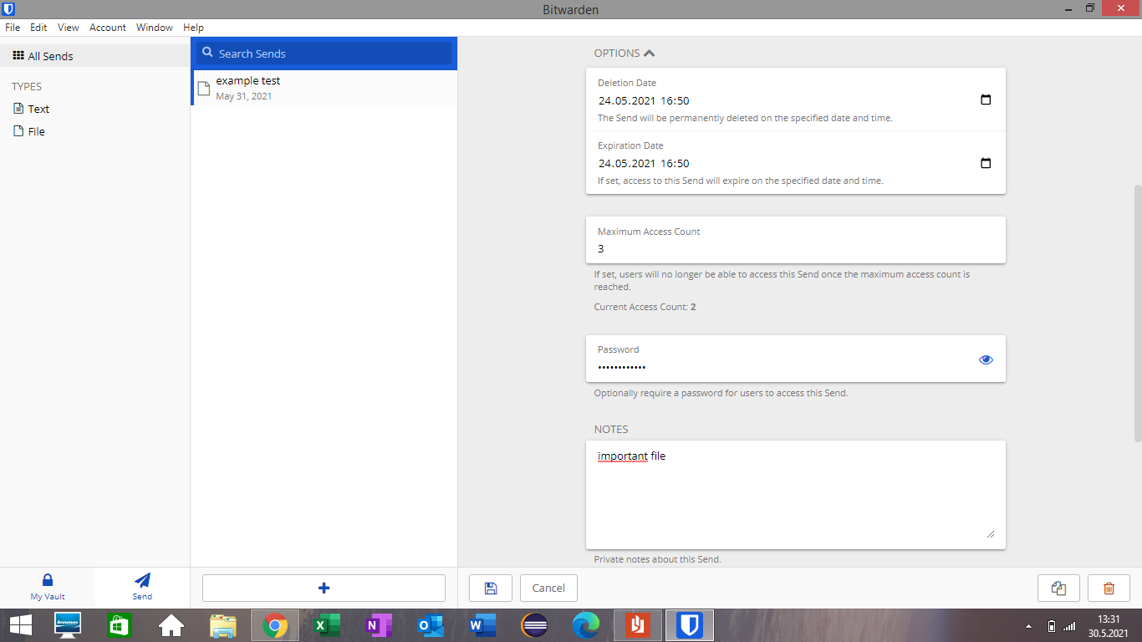

Slide 25
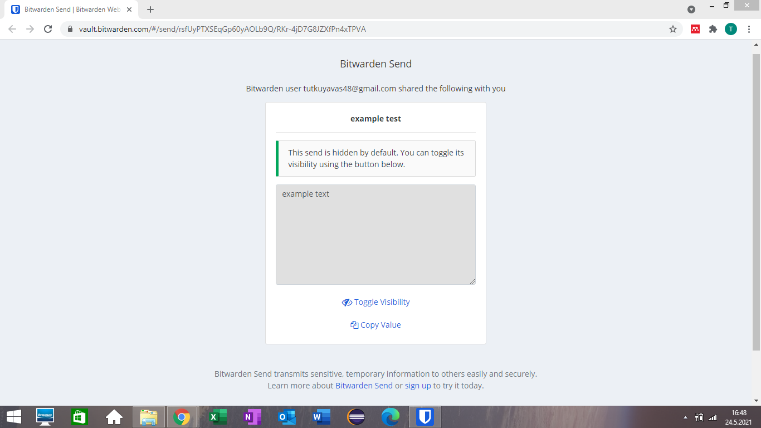

Slide 26
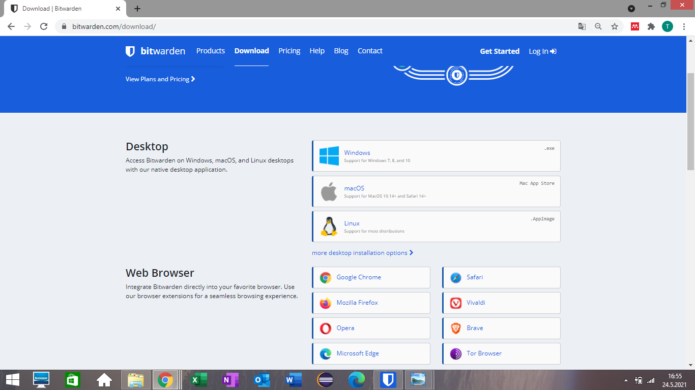
You can add it as an extension and make your transactions easier.

Slide 27
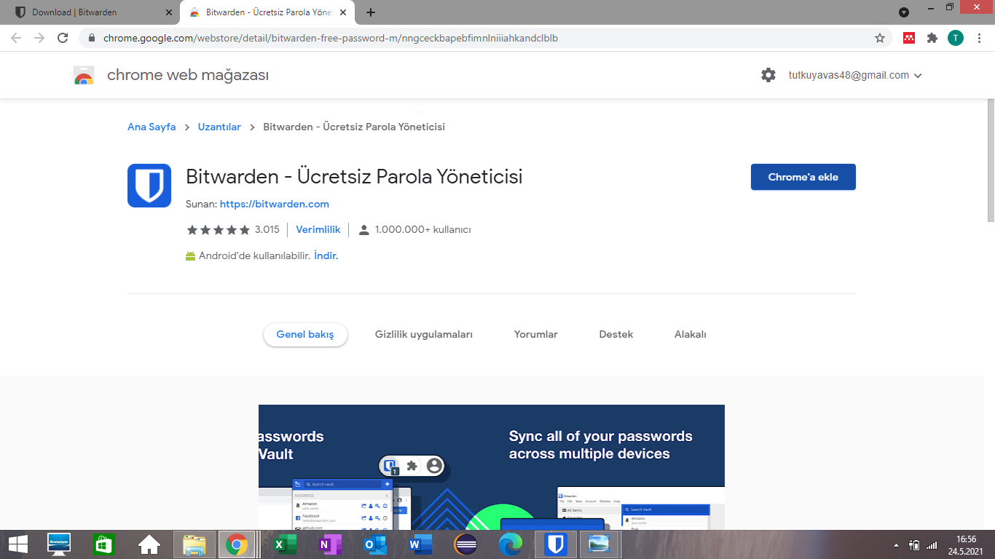

Slide 28
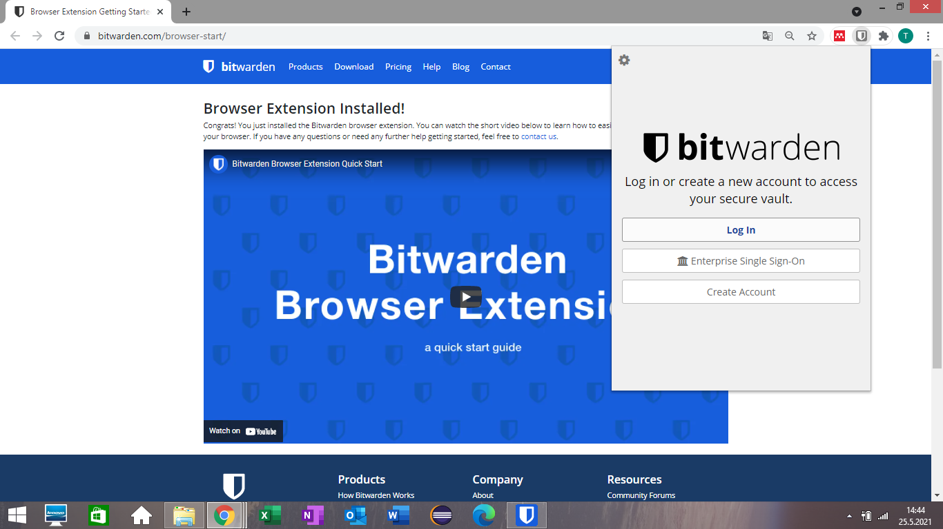

Slide 29
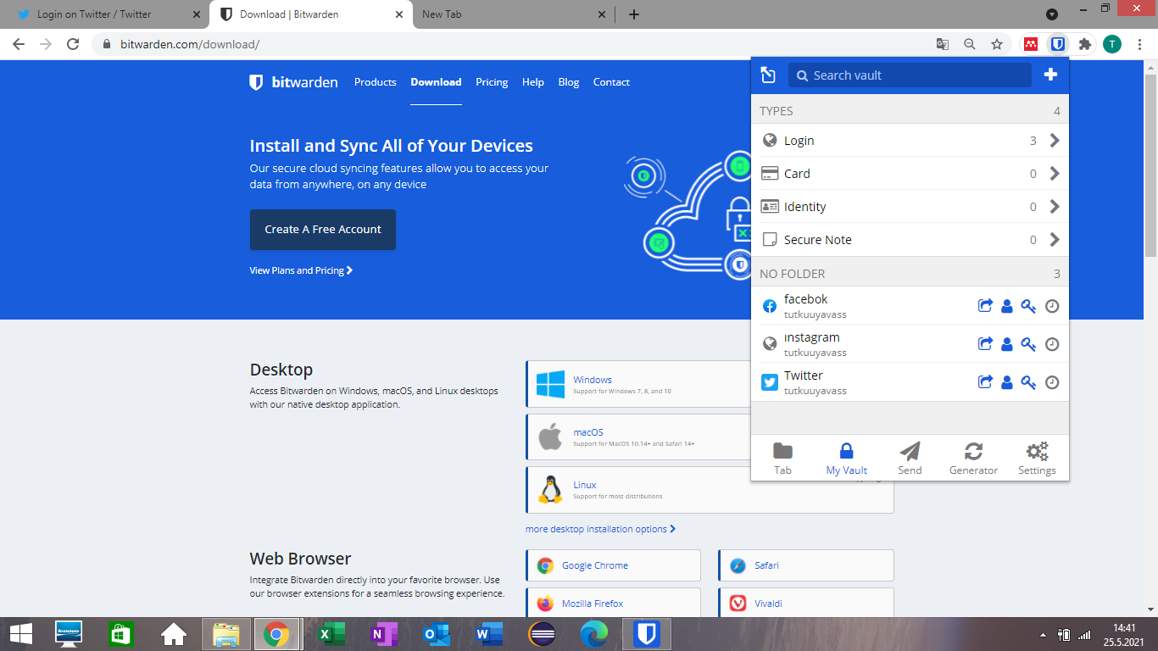

Slide 30
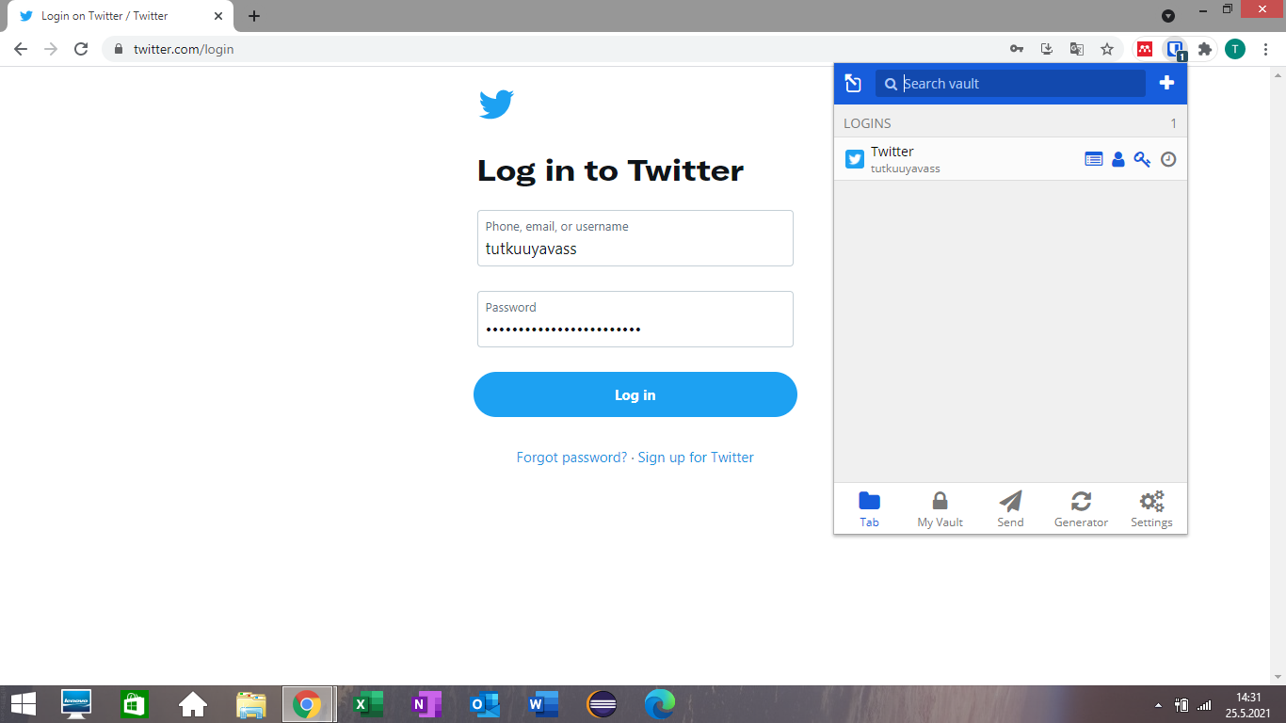
Automatically fills the website forms for you by entering your information.

Slide 31
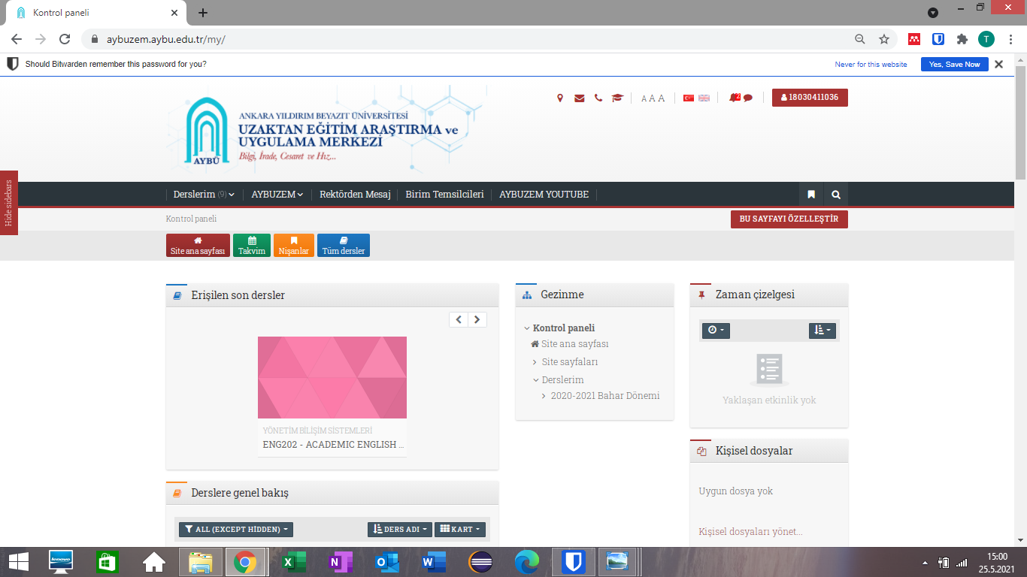

Slide 32
REFERENCES
https://bitwarden.com/
https://www.zoho.com/vault/educational-content/what-is-password-management.html
https://cybernews.com/best-password-managers/bitwarden-review/
https://www.experian.com/blogs/ask-experian/should-you-use-a-password-manager/#:~:text=To%20unlock%20the%20%22vault%22%20containing,to%20maintain%20secure%2C%20unique%20passwords.

